Slide 1
The Rady School of Management
Lecture #5
Consumer Behavior
Wed. January 22, 2020
MGT 103 Product Marketing & Management
M,W 11:00 a.m. – 12:20 p.m., OTRSN 1S114
Professor Burt De Mill

Slide 2
Announcements
Waitlist - those of you waitlisted, thanks for your patience! Please visit a Rady Undergrad advisor with questions. I don’t control the list…
Reminder- Class Participation matters….Alli will take attendance moving forward. Jump into our discussions!
Rady Labs- don’t wait until the busy end of quarter period

Slide 3
Key Points for Today’s Lecture
Review the stages in the consumer purchase decision process.
Distinguish among three variations of the consumer purchase decision process: extended, limited, and routine problem solving.
Identify the major psychological influences on consumer behavior.
Identify the major sociocultural influences on consumer behavior.

Slide 4


ENLIGHTENED CARMAKERS KNOW WHAT CUSTOM(H)ERS VALUE
Women:
Make 60 Percent of New Car Buying Decisions
Influence 84 Percent of Decisions
Key Elements of Their Decisions:
The Sense of Styling
The Need for Speed
The Substance of Safety
The Shopping Experience
Women-Drivers.com
©Blend Images/Getty Images

Slide 5
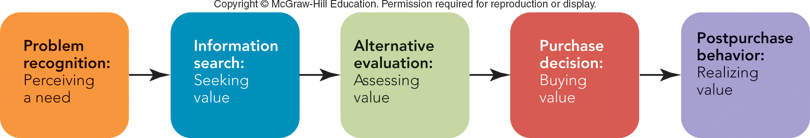
FIGURE 5-1 The purchase decision process consists of five stages.

Slide 6
CONSUMER PURCHASE DECISION PROCESS PROBLEM RECOGNITION
Purchase Decision Process
Problem Recognition Starts with the Difference Between:
Consumer’s Ideal Situation
Consumer’s Actual Situation

Slide 7
CONSUMER PURCHASE DECISION PROCESS INFORMATION SEARCH
Information Search: Seeking Value
Internal Search
External Search
Personal Sources
Public Sources
Marketer-Dominated Sources

Slide 8
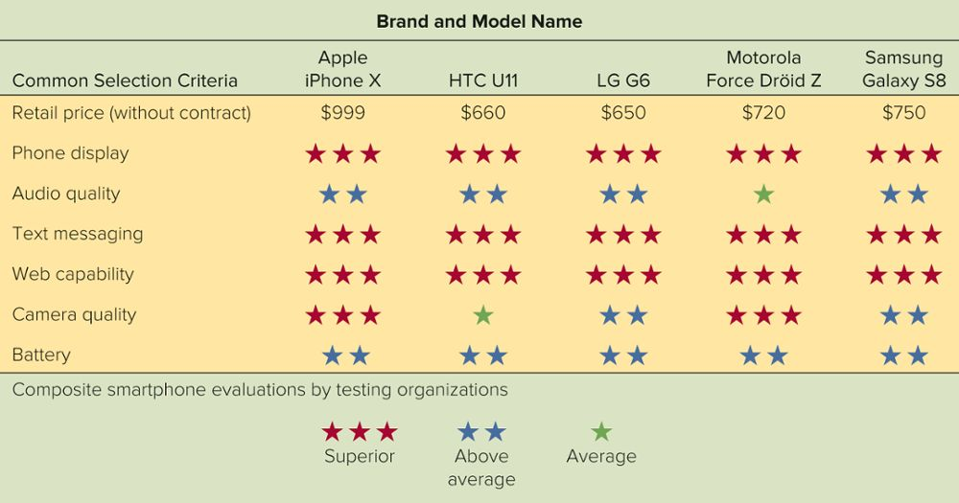
FIGURE 5-2 Common Consumer Selection Criteria for the Evaluation of Smartphones
Jump to Appendix 2 long image description

Slide 9
CONSUMER PURCHASE DECISION PROCESS ALTERNATIVE EVALUATION
Alternative Evaluation Stage:
Suggests Criteria for Purchase
Yields Brands that Meet Criteria
Develops Value Perception
Evaluative Criteria
Consideration Set

Slide 10
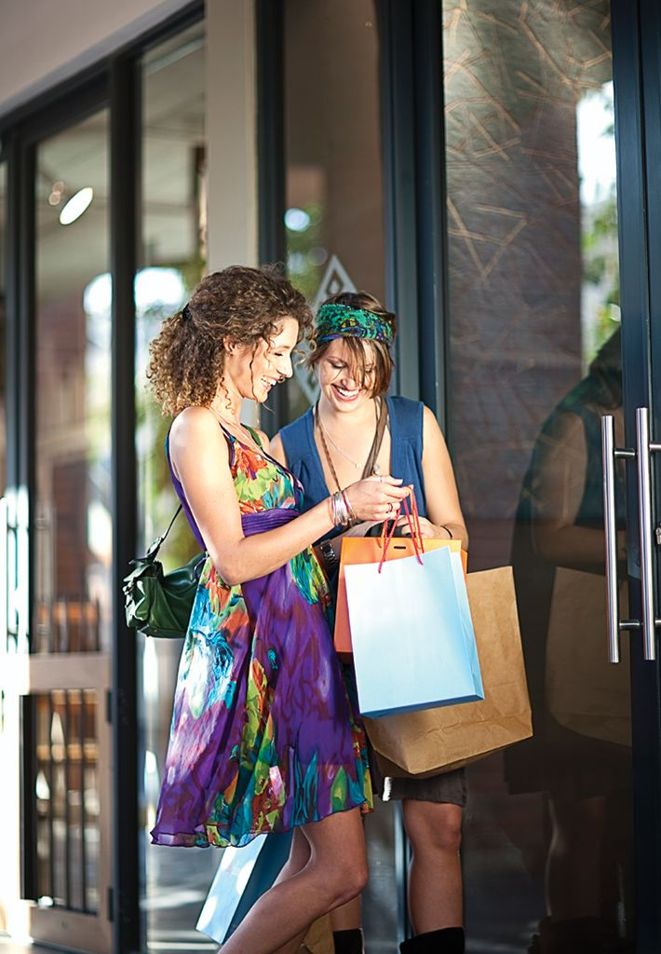
CONSUMER PURCHASE DECISION PROCESS PURCHASE DECISION
Purchase Decision: Buying Value
Make the Purchase Decision by:
Decide from Whom to Buy
Decide When to Buy
©Seb Oliver/Cultura/Getty Images

Slide 11
CONSUMER PURCHASE DECISION PROCESS POSTPURCHASE BEHAVIOR
Post purchase Behavior: Realizing Value
Customer Satisfaction Studies
Satisfied Customers Tell 3 People
Dissatisfied Customers Tell 9 People!
Cognitive Dissonance
”Buyers Remorse”
Use post sale reinforcement to alleviate

Slide 12

MARKETING MATTERS How Much Is a Satisfied Customer Worth?
Customer Satisfaction Underlies the Marketing Concept
How Much is it Worth?
Frito-Lay: Average Consumer Spends $52.50 per year
Exxon: $500 per year for Gas
Kleenex: $994 over 60 Years
Ford: Increasing Customer Retention from 60 percent to 80 percent Is Worth $100 Million in Profit per Percentage Point
Research Shows 5 Percent Increase in Retention can Increase Profits by 70-80 Percent
©DWImages Motoring/Alamy Stock Photo

Slide 13
CONSUMER PURCHASE DECISION PROCESS CONSUMER INVOLVEMENT AND PROBLEM SOLVING
Consumer Involvement Affects Problem Solving
Involvement
Extended Problem Solving (High Involvement)
Limited Problem Solving (Medium Involvement)
Routine Problem Solving (Low Involvement)

Slide 14
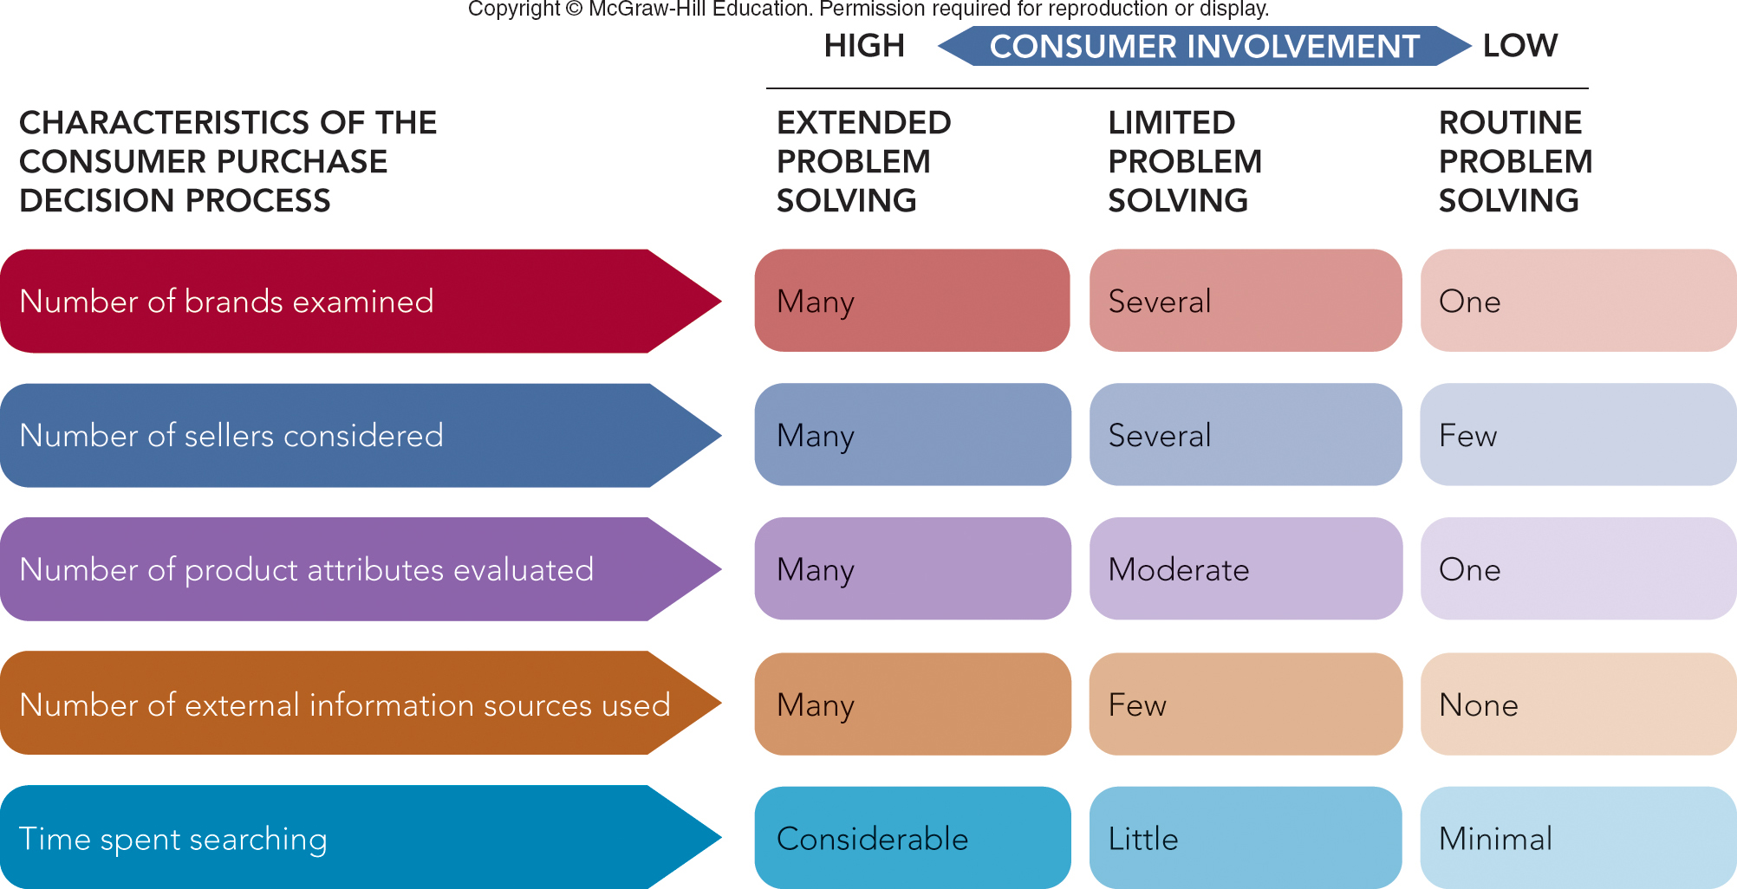
FIGURE 5-3 Comparison of problem-solving variations: extended, limited, and routine.

Slide 15
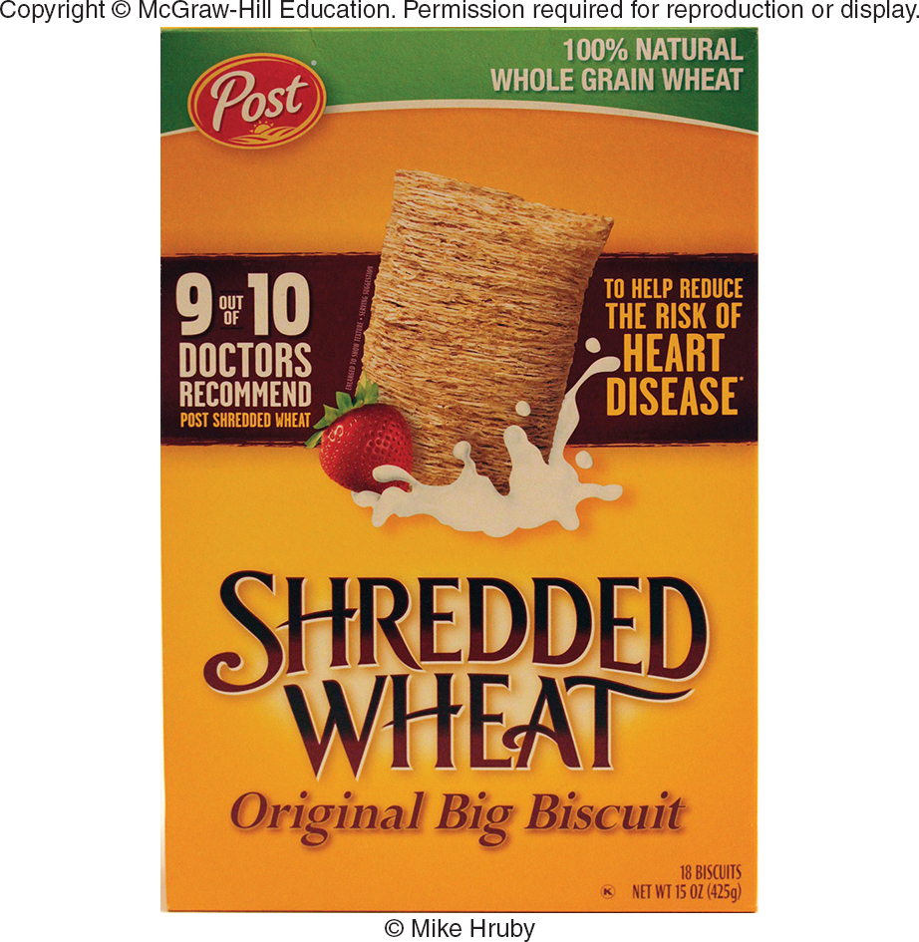
SHREDDED WHEAT What strategy is used to reduce perceived risk?
Why Do Post Cereals Display Heart-Healthy Claims on Packaging?
©McGraw-Hill Education/Mike Hruby, photographer

Slide 16
CONSUMER PURCHASE DECISION PROCESS CONSUMER INVOLVEMENT & MARKETING STRATEGY
Low Involvement
Common Products
Maintain Product Quality
Avoid Stockouts
Reduce Cognitive Dissonance with Ads
High Involvement
Consumers Seek Product Information
Use Comparative Ads
Use Personal Selling

Slide 17
CONSUMER PURCHASE DECISION PROCESS SITUATIONAL INFLUENCES
Situational Influences Affect Purchase Decisions
Situational Influences
Purchase Task
Social Surroundings
Physical Surroundings
Temporal Effects
Antecedent States

Slide 18
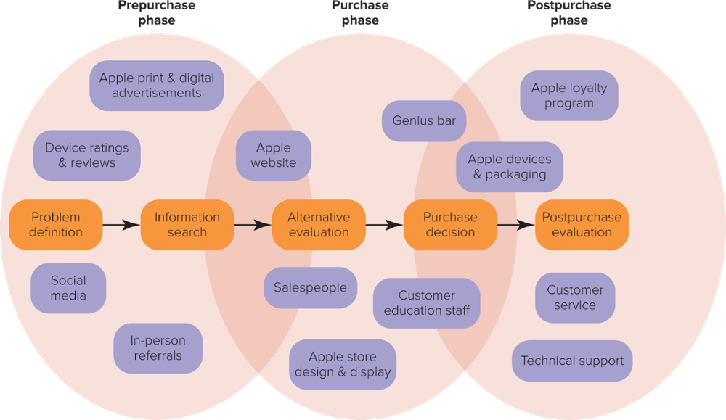
FIGURE 5-4 Apple Consumer Journey Map and Consumer Touchpoints for Electronic Devices Sold in Apple Stores

Slide 19
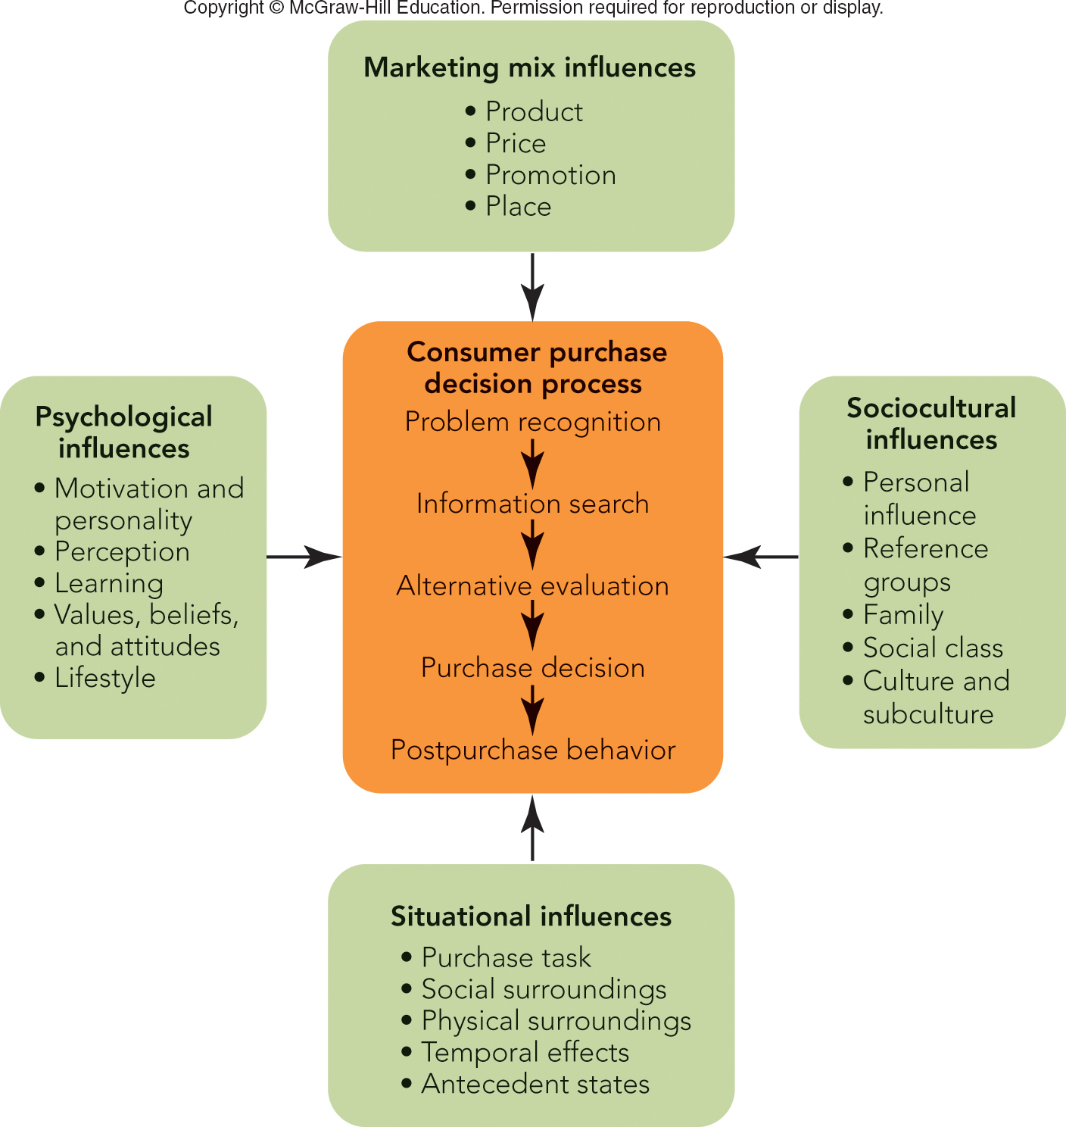
FIGURE 5-5 Influences on the consumer purchase decision process from both internal and external sources.

Slide 20
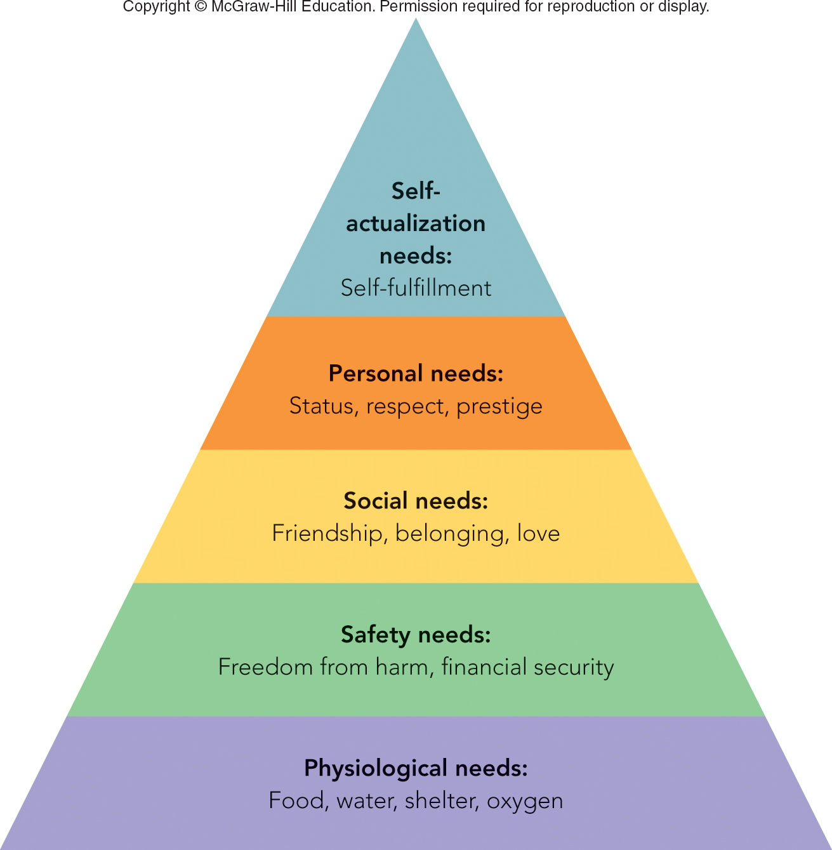
FIGURE 5-6 Maslow’s Hierarchy of needs - why do we buy?

Slide 21
PSYCHOLOGICAL INFLUENCES ON CONSUMER BEHAVIOR PERSONALITY
Personality
Self-Concept
Key Traits – Enduring Characteristics of a Person:
Assertiveness
Extroversion
Compliance
Dominance, etc.

Slide 22
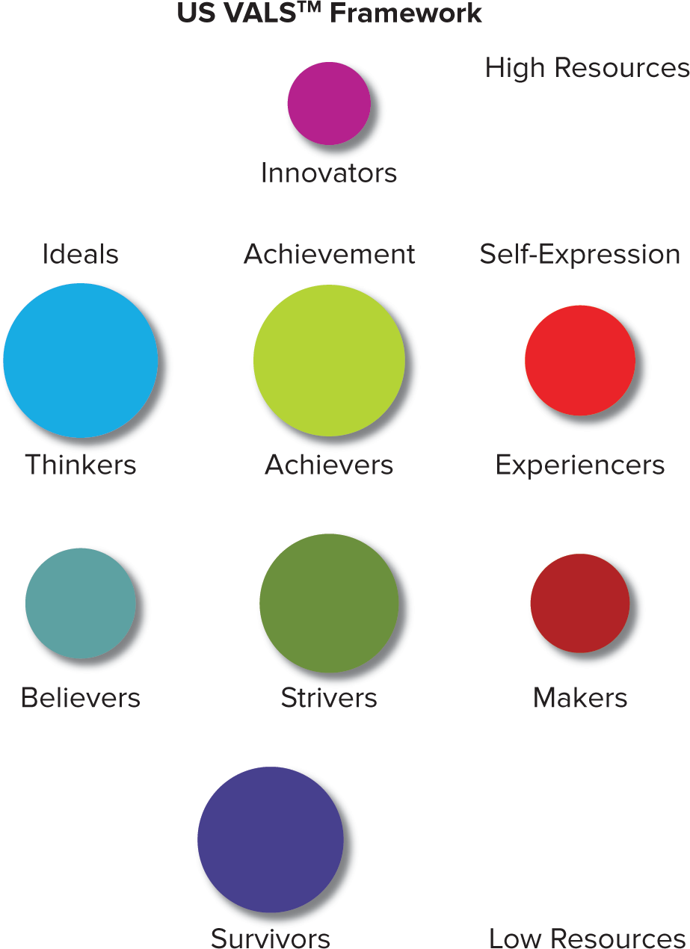
FIGURE 5-7 VALS™ Identifies 8 Consumer Segments
Consumers with Abundant Resources Are Near Top of Framework
Consumers with Minimal Resources Are at the Bottom of Framework
Consumer Groups within a Motivation Can Be Targeted Together.
Ideals Motivated Groups:
Thinkers, Believers
Achievement Motivated Groups:
Achievers, Strivers
Self-Expression Motivated Groups:
Experiencers, Makers
High and Low Resource Groups:
Innovators, Survivors
VALS Types
© 2017 by Strategic Business Insights. All Rights Reserved. www.strategicbusinessinsights.com/vals

Slide 23
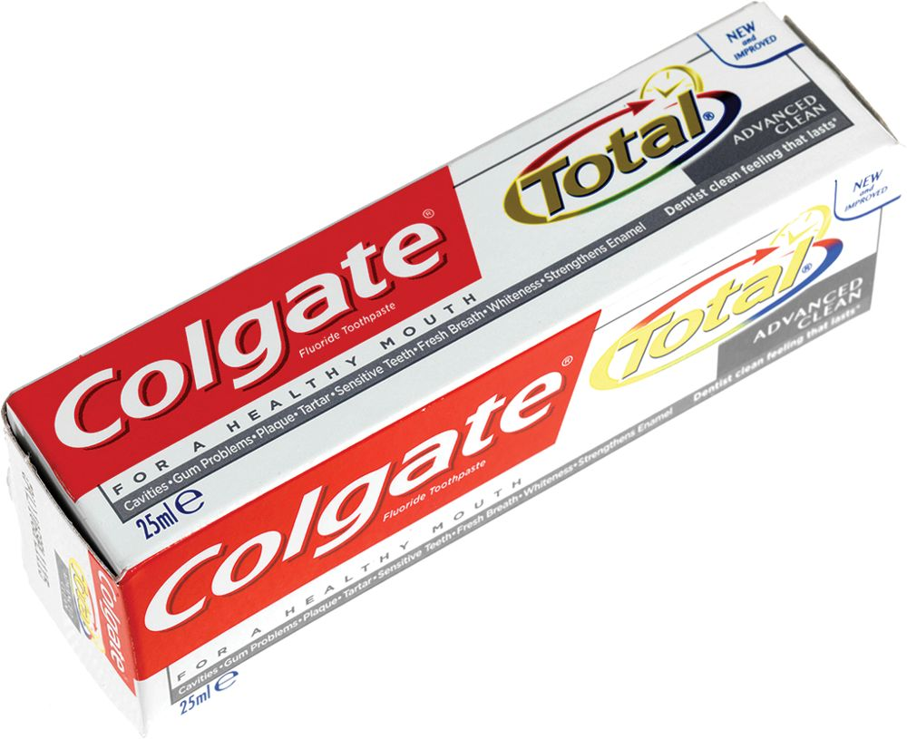
PSYCHOLOGICAL INFLUENCES ON CONSUMER BEHAVIOR CONSUMER PERCEPTION (2 of 2)
Strategies to Reduce Perceived Risk
Obtain Seals of Approval
Secure Endorsements
Provide Free Trials/Samples
Give Extensive Instructions
Provide Warranties/Guarantees
©Whitebox Media/Alamy Stock Photo

Slide 24
PSYCHOLOGICAL INFLUENCES ON CONSUMER BEHAVIOR CONSUMER VALUES, BELIEFS, AND ATTITUDES (1 of 2)
Attitude Formation – Learned Response to Objects in Consistent Way (Favorable or Unfavorable)
Attitude
Values Affect Attitudes
Beliefs

Slide 25
PSYCHOLOGICAL INFLUENCES ON CONSUMER BEHAVIOR CONSUMER VALUES, BELIEFS, AND ATTITUDES (2 of 2)
Marketers Use Three Approaches to Change Attitudes:
Change Beliefs About a Brand’s Attributes
Change Perceived Importance of Attributes!
Add New Product Attributes

Slide 26
PSYCHOLOGICAL INFLUENCES ON CONSUMER BEHAVIOR CONSUMER LIFESTYLE
Lifestyle
How People Spend Their Time and Resources
Lifestyle Analysis Useful for Targeting Consumers

Slide 27
SOCIOCULTURAL INFLUENCES ON CONSUMER BEHAVIOR PERSONAL INFLUENCE
Consumers’ Purchases Often Influenced by Others
Opinion Leaders
Word of Mouth
Buzz Can Be Either Positive or Negative
Dove Video

Slide 28

SOCIOCULTURAL INFLUENCES ON CONSUMER BEHAVIOR REFERENCE GROUPS
Reference Groups
Associative Group
Brand Community
Aspiration Group
Dissociative Group
©Joseph Eid/AFP/Getty Images

Slide 29
VIDEO CASE – Key Considerations Coppertone
How has knowledge of consumer behavior helped Coppertone grow in the United States and around the globe?
Describe the five-stage purchase decision process for a Coppertone customer.
What are the possible situational, psychological, and sociocultural influences on the Coppertone consumer purchase decision process?
What specific marketing activities does Coppertone utilize to help Coppertone grow in the marketplace?

Slide 30
COPPERTONE: CREATING THE LEADING SUN CARE BRAND BY UNDERSTANDING CONSUMERS
Coppertone Video Case

Slide 31
Homework Assignment
Tesla, SWOT Analysis – 50-point value
You are the Marketing Manager responsible for the automobile division at Tesla
Present current strengths, weaknesses, opportunities and threats.
Six bullet points per quadrant. Maximum of 2 sentences per point.
Opportunities should focus on new products, services & markets as well as external forces considering current and future competition
Due date – Monday January 27th at 5:00 p.m.
This is an individual assignment; not group work

Slide 32
Reading & Homework Assignments for Monday
Chapter #6, Organizations as Customers
Homework Assignment Due Monday, January 27th at 5:00 p.m.
Office Hours on Thursday, 2:00 – 3:00 p.m. 2E108 Rady Undergrad
See you next week!

Slide 33
The Rady School of Management
Lecture #5
Consumer Behavior
Wed. January 22, 2020
MGT 103 Product Marketing & Management
M,W 11:00 a.m. – 12:20 p.m., OTRSN 1S114
Professor Burt De Mill

Slide 34

MARKETING MATTERS BzzAgent—The Buzz Experience
Word-of-Mouth Experiences Are Powerful
Worldwide Volunteer Army of 1,000,000+
Captures Honest Word-of-Mouth
“Agent” Database of Customers Receive Sample Product and Manual for Creating Buzz
Agents Keep Products and Earn Points
BzzAgent
©BzzAgent

